Slide 1
A Neural Algorithm of Artistic Style
授課老師：邱垂昱
組員：111378013 顧芸瑄 111378048 黃駿易
111378061 謝庭瑋 111378069 葉子潔
111378073 游家雯 111378076 藍楷崴
111378077 高子晴

Slide 2

Table Of Content
1
Introduction
4
show
2
Method
5
Conclusion
3
code
6
Q&A

Slide 3
Introduction

Slide 4
Introduction
In the field of art, especially in painting, humans have acquired the skill of creating unique visual experiences through complex interactions between the content and style of an image. Until now, the algorithmic basis of this process has remained unknown, and there has been no artificial system with similar capabilities. However, recently, biologically inspired visual models have demonstrated success in other key areas of visual perception, such as object and face recognition.

Slide 5
Introduction
We will introduce an artificial system based on deep neural networks that can create art images of high perceptual quality. The system uses neural representations to separate and recombine the content and style of arbitrary images, providing a neural algorithm for artistic image creation. Furthermore, given the similarities between performance-optimized artificial neural networks and biological vision, understanding how humans create and perceive artistic imagery through algorithms offers a pathway.

Slide 6
Method

Slide 7
Method
We used the feature space provided by the 16 convolutional and 5 pooling layers of the 19 layer VGG-Network. We do not use any of the fully connected layers.The model is publicly available and can be explored in the caffe-framework.For image synthesis we found that replacing the max-pooling operation by average pooling improves the gradient flow and one obtains slightly more appealing results, which is why the images shown were generated with average pooling.

Slide 8
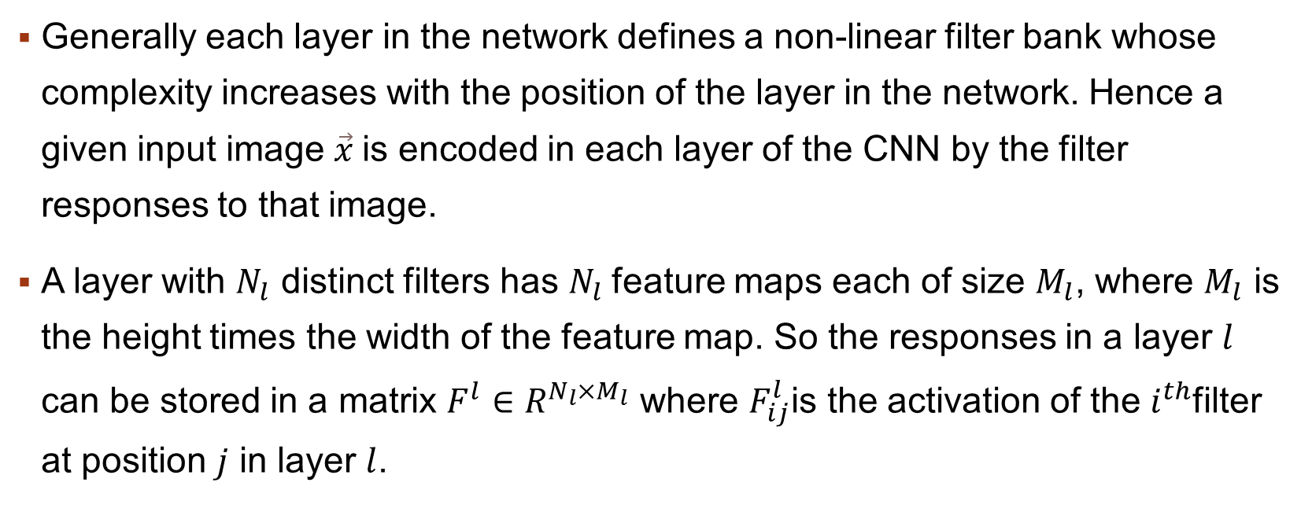
Method
Generally each layer in the network defines a non-linear filter bank whose complexity increases with the position of the layer in the network. Hence a given input image $\vec{x}$is encoded in each layer of the CNN by the filter responses to that image.
A layer with $N_{l}$ distinct filters has $N_{l}$feature maps each of size $M_{l}$, where $M_{l}$ is the height times the width of the feature map. So the responses in a layer $l$ can be stored in a matrix $F^{l}∈R^{N_{l}×M_{l}}$ where $F_{ij}^{l}$is the activation of the $i^{th}$filter at position $j$ in layer $l$.

Slide 9
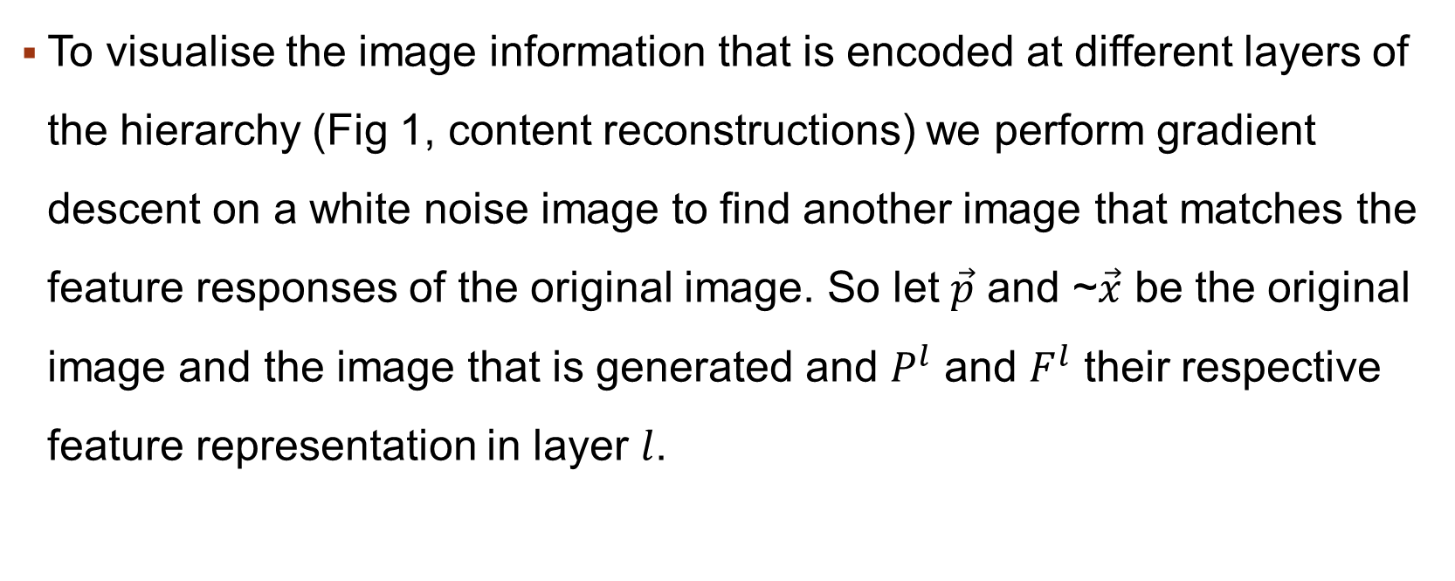
Method
To visualise the image information that is encoded at different layers of the hierarchy (Fig 1, content reconstructions) we perform gradient descent on a white noise image to find another image that matches the feature responses of the original image. So let $\vec{p}$ and ~$\vec{x}$ be the original image and the image that is generated and $P^{l}$ and $F^{l}$ their respective feature representation in layer $l$.

Slide 10
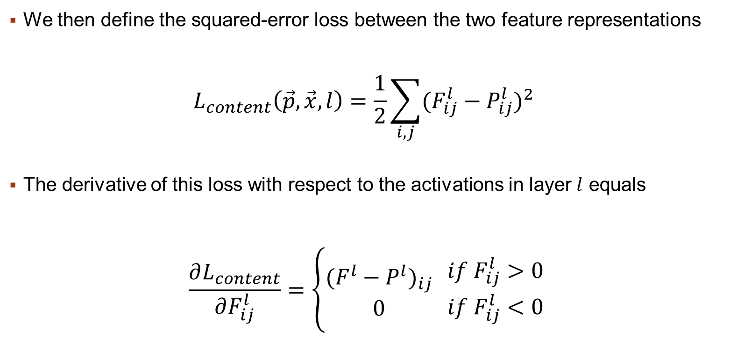
Method
We then define the squared-error loss between the two feature representations
$$L_{content}\left(\vec{p},\vec{x},l\right)=\frac{1}{2}\sum_{i,j}{{(F_{ij}^{l}−P_{ij}^{l})}^{2}}$$
The derivative of this loss with respect to the activations in layer $l$ equals
$$\frac{∂L_{content}}{∂F_{ij}^{l}}=\left\{\begin{aligned}{(F^{l}−P^{l})}_{ij} \\ 0\end{aligned} {if{ F}_{ij}^{l}>0 \atop if{ F}_{ij}^{l}<0}\right.$$

Slide 11
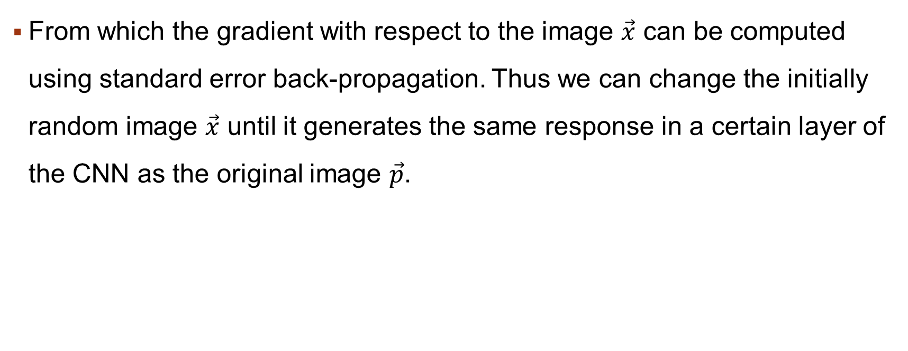
Method
From which the gradient with respect to the image $\vec{x}$ can be computed using standard error back-propagation. Thus we can change the initially random image $\vec{x}$ until it generates the same response in a certain layer of the CNN as the original image $\vec{p}$.

Slide 12
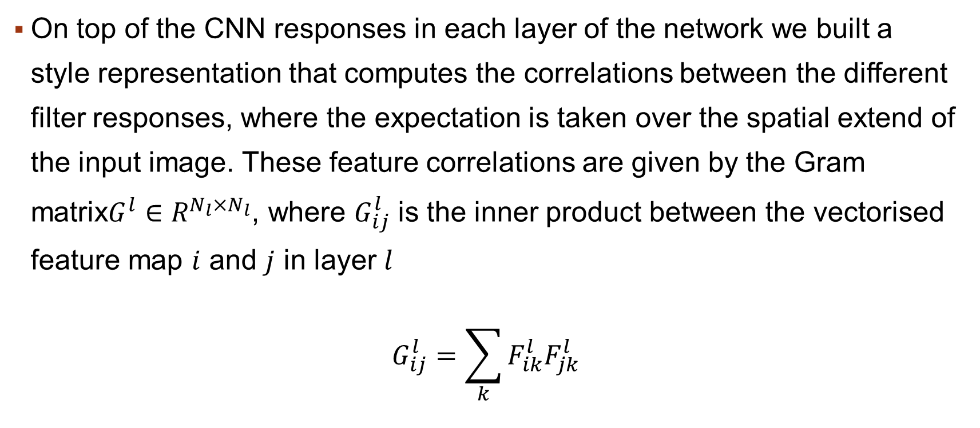
Method
On top of the CNN responses in each layer of the network we built a style representation that computes the correlations between the different filter responses, where the expectation is taken over the spatial extend of the input image. These feature correlations are given by the Gram matrix$G^{l}∈R^{N_{l}×N_{l}}$, where $G_{ij}^{l}$ is the inner product between the vectorised feature map $i$ and $j$ in layer $l$
$$G_{ij}^{l}=\sum_{k}{F_{ik}^{l}F_{jk}^{l}}$$

Slide 13
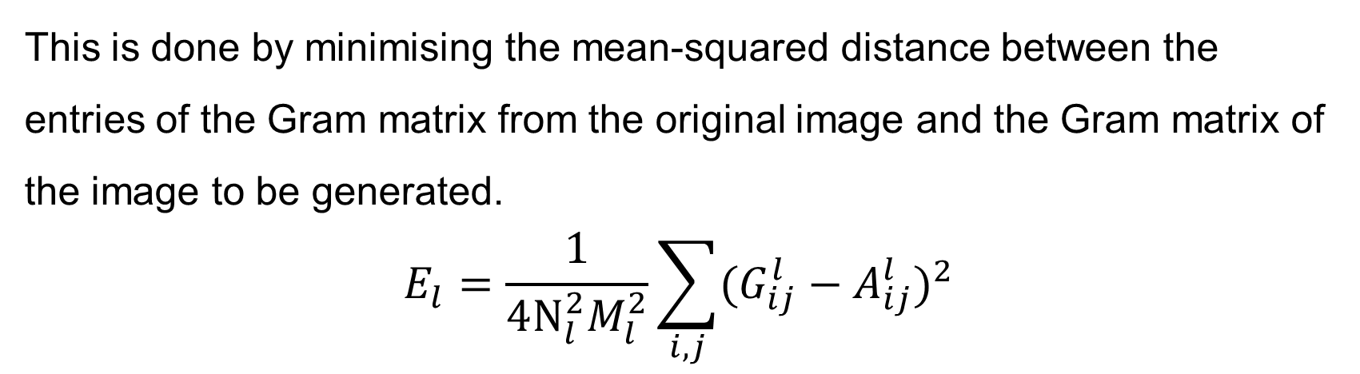


Method
This is done by minimising the mean-squared distance between the entries of the Gram matrix from the original image and the Gram matrix of the image to be generated.
$$E_{l}=\frac{1}{4N_{l}^{2}M_{l}^{2}}\sum_{i,j}{{(G_{ij}^{l}−A_{ij}^{l})}^{2}}$$
$\vec{a}$ and $\vec{x}$ be the original image and the image that is generated
and the total loss is
$$L_{style}\left(\vec{a},\vec{x}\right)=\sum_{l=0}^{L}{w_{l}E_{l}}$$
$w_{l}$: weighting factors of the contribution of each layer to the total loss

Slide 14
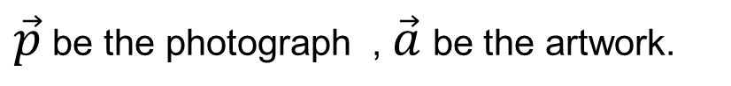
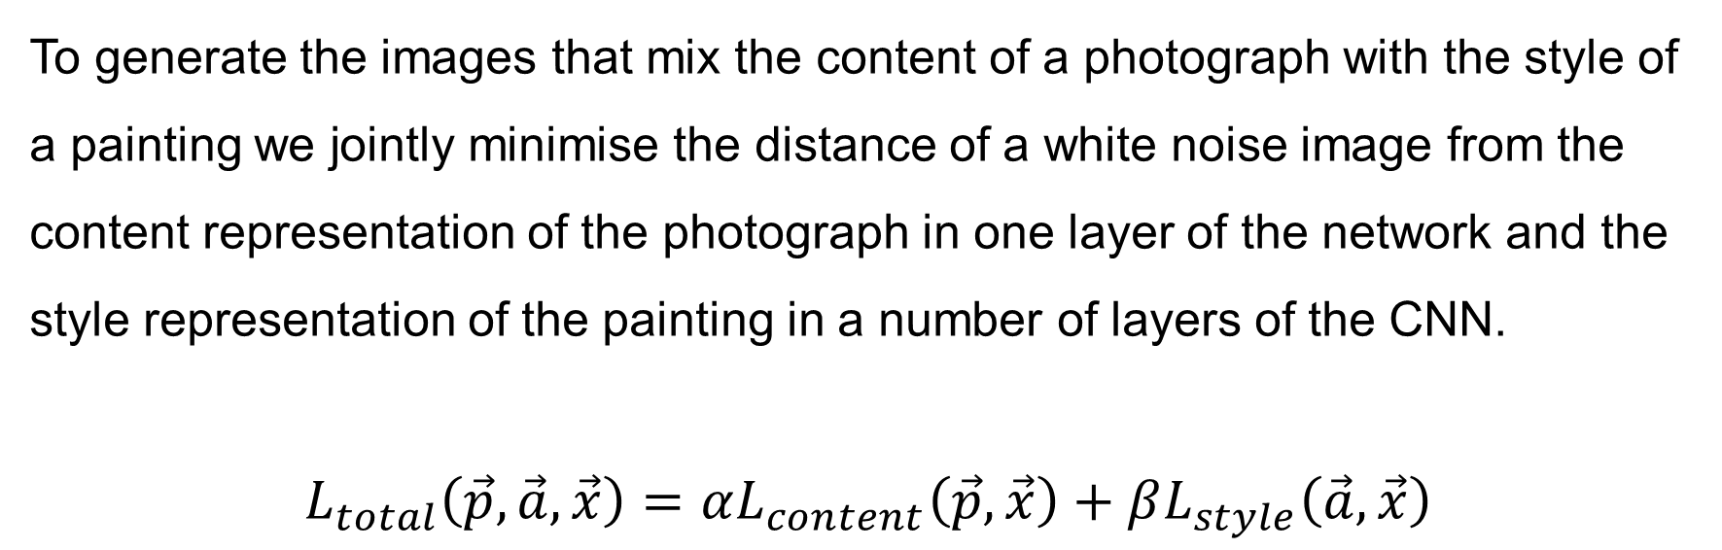
Method
To generate the images that mix the content of a photograph with the style of a painting we jointly minimise the distance of a white noise image from the content representation of the photograph in one layer of the network and the style representation of the painting in a number of layers of the CNN.
$$L_{total}\left(\vec{p},\vec{a},\vec{x}\right)=αL_{content}\left(\vec{p},\vec{x}\right)+βL_{style}\left(\vec{a},\vec{x}\right)$$
$\vec{p}$ be the photograph , $\vec{a}$ be the artwork.
$α,β$ :weighting factors for content and style reconstruction respectively.

Slide 15
code

Slide 16
Method
def make_torch_input(filename, layers, loss_functions, args):
1. filename (the name of the file to be written)
2.layers
(a list containing layer information)
3.loss_functions
(a 2D list containing loss function information)
4.args (a 3D list containing parameter information)
def make_torch_init(filename, init)
Auxiliary function used to write initialization data to an HDF5 file.
def get_torch_output(filename)
Auxiliary function used to retrieve Torch's output data from an HDF5 file.
def get_torch_loss(filename):
Auxiliary function used to retrieve Torch's loss value data from an HDF5 file.

Slide 17
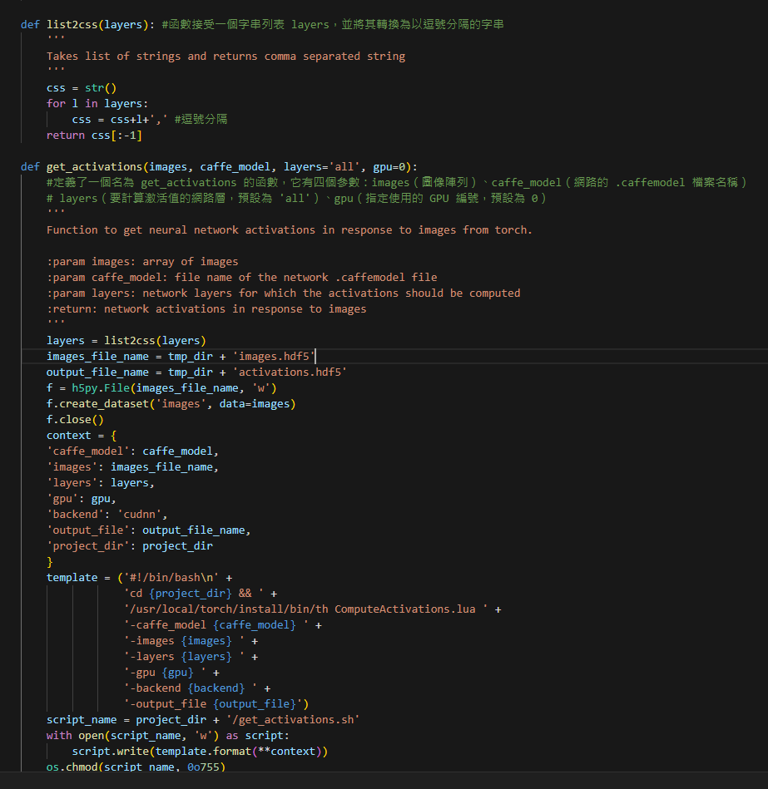
Method
def list2css(layers):
The function takes a list of strings, layers,
and converts it into a comma-separated string.
def get_activations
(images, caffe_model, layers='all', gpu=0):
The get_activations function is defined with four parameters: images (an array of images), caffe_model (the filename of the network's .caffemodel file), layers (the network layers for which activations are to be computed, defaulting to 'all'), and gpu (specifying the GPU number to be used, defaulting to 0).

Slide 18
Method
Preprocessing and inverse preprocessing are performed to ensure consistency between the input and output of a model and to ensure stability and effectiveness in processing images. The following explanations clarify the need for these preprocessing and inverse preprocessing steps:

Slide 19
Method
Preprocessing:
Normalization: Deep learning models often normalize the input, scaling the pixel values to a fixed range such as [0, 1] or [-1, 1]. This helps improve the stability and convergence speed of the model.
Mean subtraction: Subtracting the mean value from each channel of an image. The purpose is to eliminate the overall brightness variation in the image, allowing the model to focus more on subtle texture and structural information.
Channel order adjustment: In different deep learning frameworks, the channel order of an image may vary, such as RGB in Torch or BGR in other frameworks. Adjusting the channel order ensures consistency in the model's input.

Slide 20
Method
Inverse preprocessing:
Mean addition: When performing inverse preprocessing on the model's predicted output, it is necessary to add back the previously subtracted mean value to restore the overall brightness of the image.
Inverse normalization: Reversing the normalization process on the pixel values of the predicted output, mapping the values back to the original range, such as [0, 255].
These preprocessing and inverse preprocessing steps ensure consistency between the model's input and output and help the model achieve better performance and accuracy in image processing. This approach can improve the interpretability of the model and ensure that the output results are visually understandable. Additionally, these steps contribute to maintaining numerical stability and preventing issues such as gradient explosions or vanishing gradients.

Slide 21
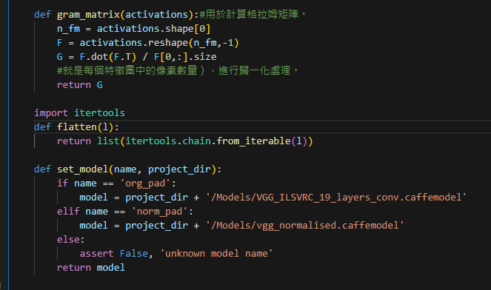
Method
def gram_matrix(activations):
The function is used to calculate the Gram matrix given the activations
To perform normalization on the Gram matrix, you can divide each element by the number of pixels in each feature map. This will ensure that the values are normalized based on the size of each feature map.

Slide 22
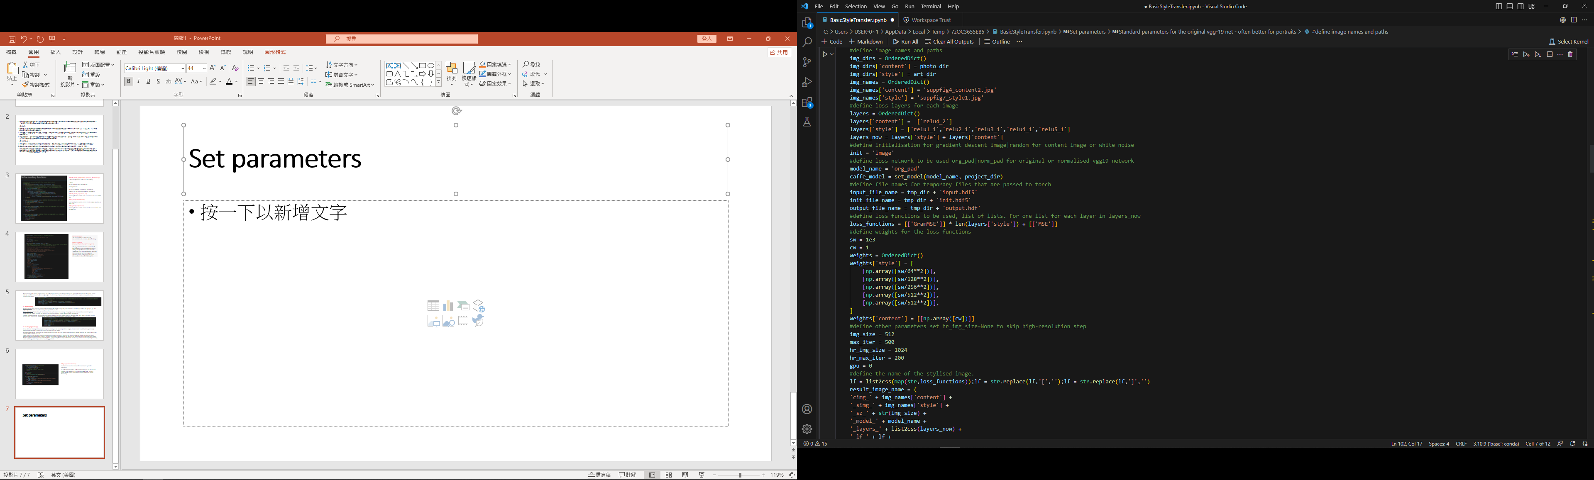
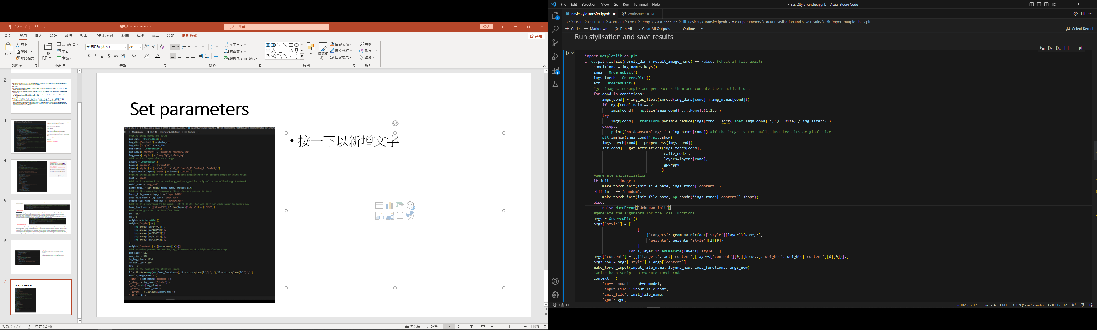
Set parameters
Method
Run stylisation and save results

Slide 23
show

Slide 24
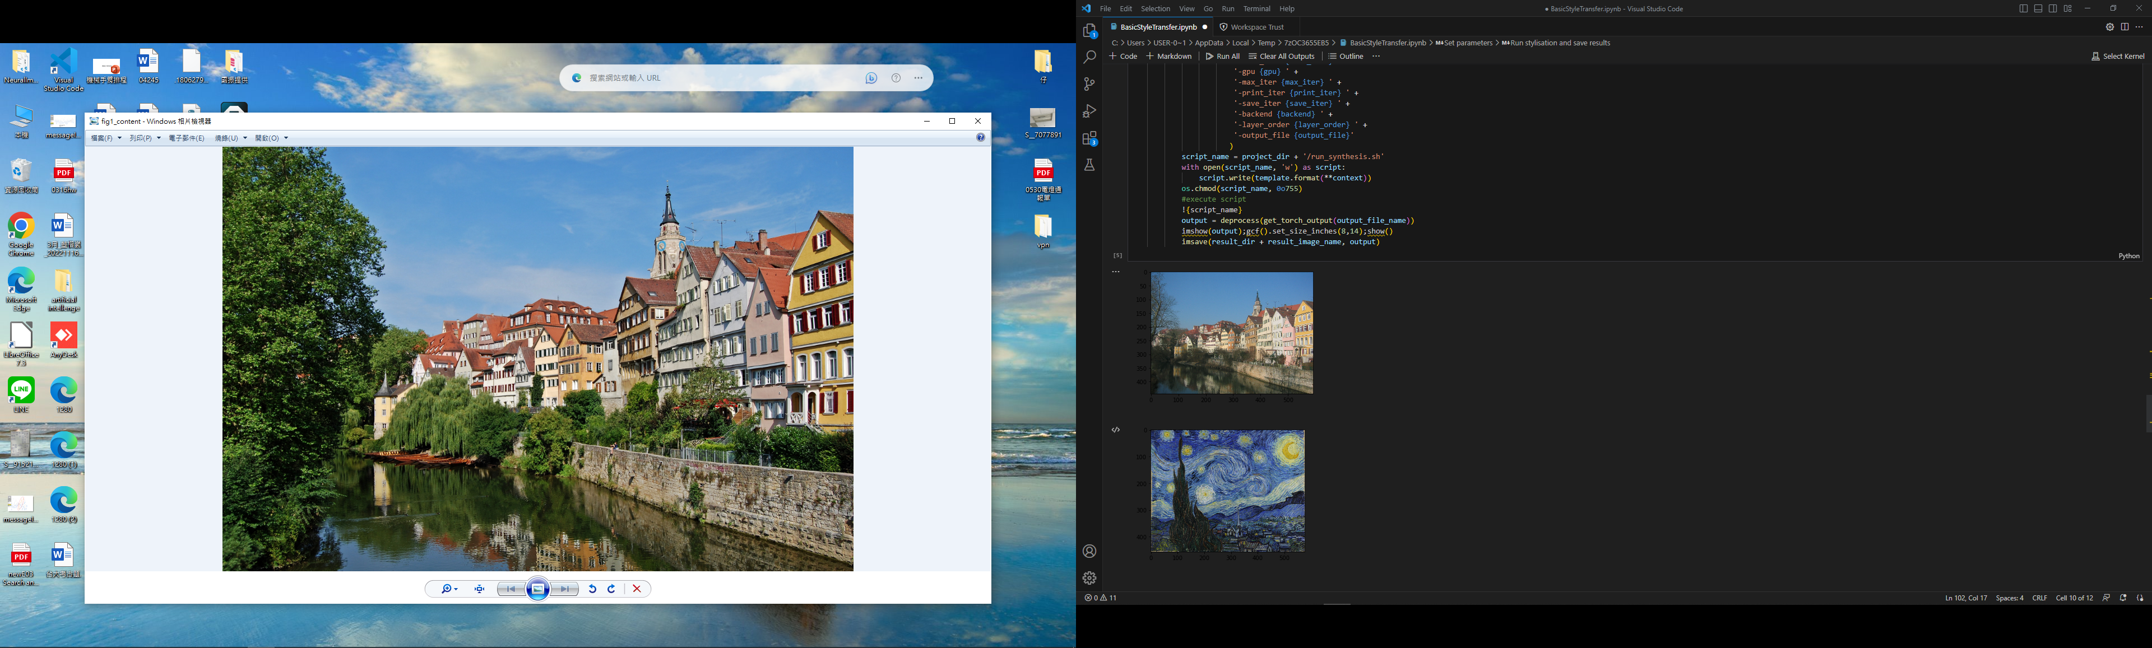
Show

Slide 25
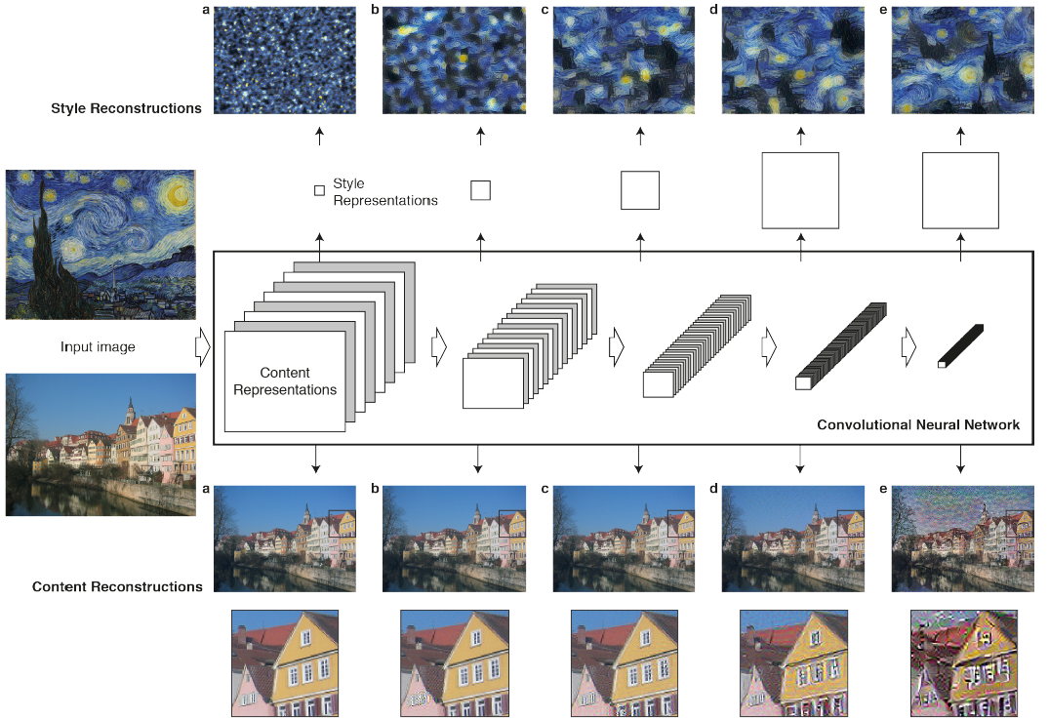
Show
Convolutional Neural Networks
The class of Deep Neural Networks that are most powerful in image processing tasks are called Convolutional Neural Networks. Convolutional Neural Networks consist of layers of small computational units that process visual information hierarchically in a feed-forward manner.
Content reconstructions
Higher layers in the network capture the high-level content in terms of objects and their arrangement in the input image but do not constrain the exact pixel values of the reconstruction.
Style reconstructions
Visualise the information captured by these style feature spaces built on different layers of the network by constructing an image that matches the style representation of a given input image

Slide 26
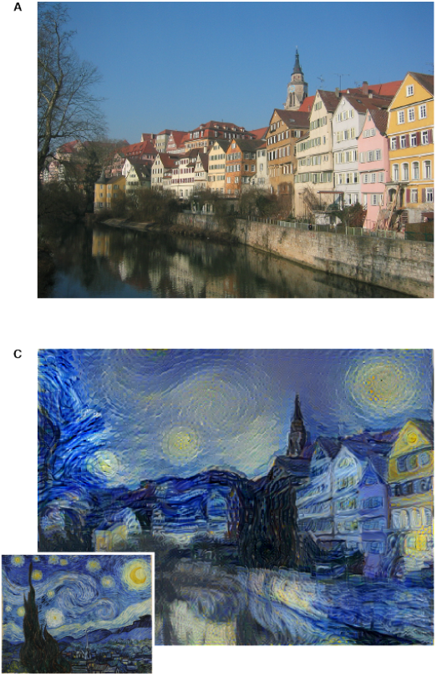
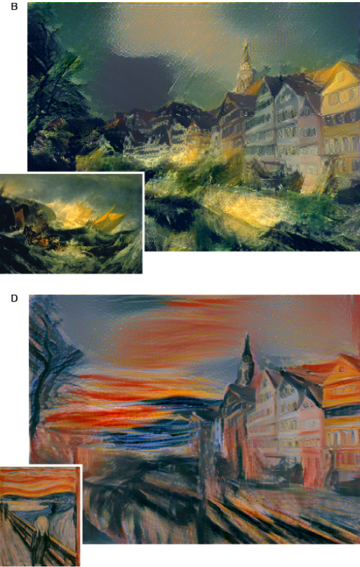
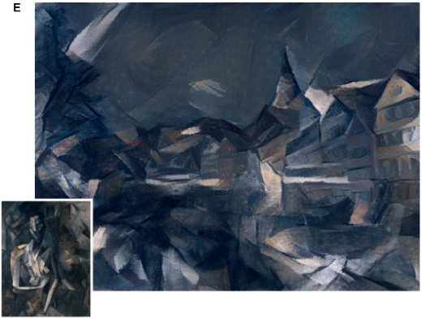
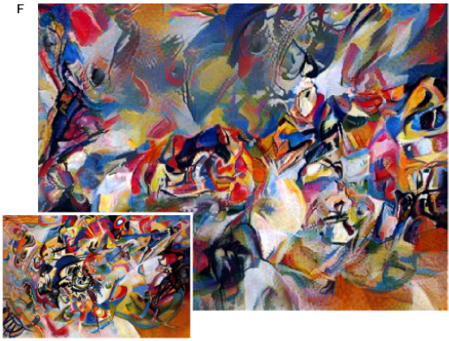
Show
The key finding of this paper is that the representations of content and style in the Convolutional Neural Network are separable. That is, we can manipulate both representations independently to produce new, perceptually meaningful images

Slide 27
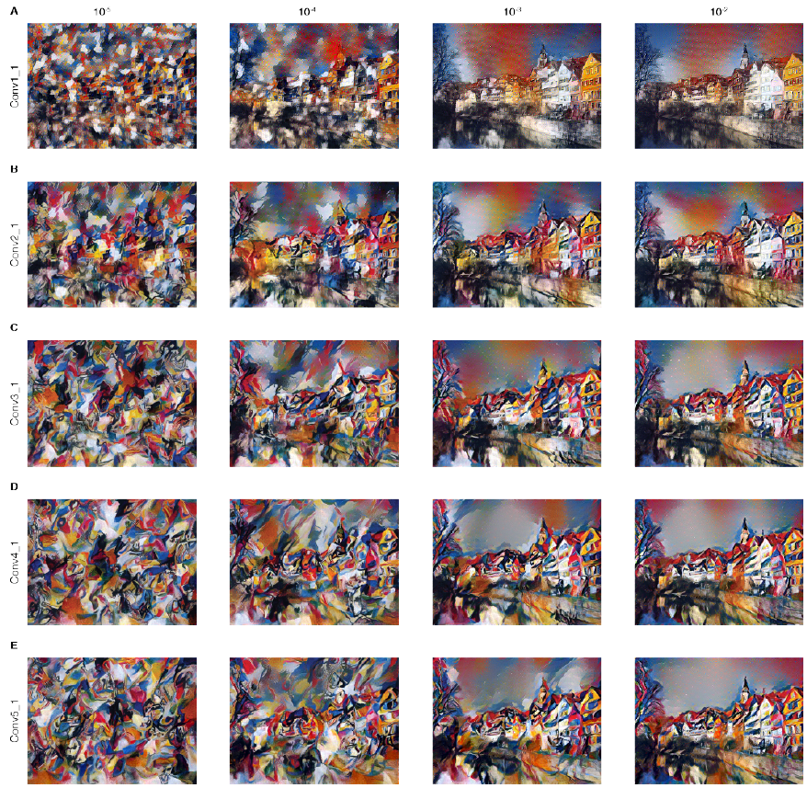
Show
The rows show the result of matching the style representation of increasing subsets of the CNN layers. They find that the local image structures captured by the style representation increase in size and complexity when including style features from higher layers of the network.

Slide 28
Conclusion

Slide 29
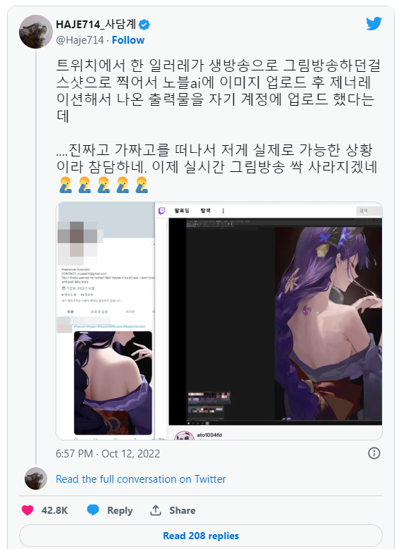
Conclusion
On October 12, 2022, there was a live drawing session by an artist, and a viewer used NovelAI to draw based on the artist's sketch. The viewer then published their finished artwork 5 hours earlier than the artist and criticized the original artist for plagiarism on the internet.

Slide 30
Conclusion
In today's society, many things can be accomplished through AI. Whether it's AI painting or AI music, they both demonstrate the increasingly broad scope of AI's future development. Therefore, for our research, we are focusing on this direction.
We believe that once this technology matures in the future, it can be widely applied in the field of art. However, at the same time, we need to pay attention to ethical and legal issues.

Slide 31
Q & A

Slide 32
Thank you

